Slide 1










BCS202L- Data Structures and Algorithms
Dr. Priyanka N
Assistant Professor Senior Grade 1
School of Computer Science & Engineering VIT, Vellore.

Slide 2
BCS202L- Data Structures and Algorithms
Module-1: Algorithm Analysis
Module-2: Linear Data Structures
Module-3: Searching and Sorting
Module-4:Trees
Module-5: Graphs
Module-6: Hashing
Module-7: Heaps and AVL Trees

Slide 3

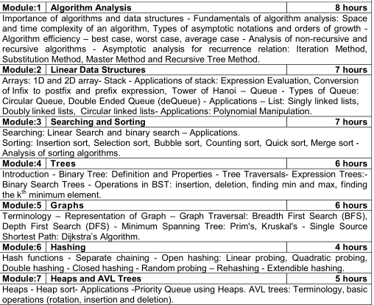

Slide 4
BCS202L- Data Structures and Algorithms
Text Books:
1. Mark A. Weiss, Data Structures & Algorithm Analysis in C++, 4 th
Edition, 2013,Pearson Education.
Reference Books:
Alfred V. Aho, Jeffrey D. Ullman and John E. Hopcroft, Data
Structures and Algorithms,1983, Pearson Education.
Horowitz, Sahni and S. Anderson-Freed, Fundamentals of Data Structures in C, 2008, 2nd Edition, Universities Press.
Thomas H. Cormen, C.E. Leiserson, R L. Rivest and C. Stein,
Introduction to Algorithms, 2009, 3rd Edition, MIT Press.

Slide 5
Introduction to Spanning Trees
A spanning tree is a subset of graph G, which has all the vertices covered with minimum possible number of edges.
A spanning does not have cycles as well as every vertex is connected.
Hence, every connected undirected graph has at least one spanning tree.
No. of spanning trees for a complete undirected graphs n^{(n-2)} where n is number of vertices.
A
A
A
A
5
10
10
5
10
5
3
B
3
B
B
C
B
C
C
C
3
Graph G
Spanning Trees

Slide 6
Examples
No. of edges in a spanning tree are n-1, where n is number of vertices.
A
B
A
B
C
D
C
D
Graph G
Spanning Trees

Slide 7
Examples
B
A
B
A
D
C
D
C

Slide 8
Examples
No. of edges in a spanning tree are n-1, where n is number of vertices.
B
B
A
D
C
A
D
C
G
F
G
F
Graph G
Spanning Trees

Slide 9
Properties of spanning trees
A connected graph G can have more than one spanning tree.
A disconnected graph do not have spanning trees.
All possible spanning trees of graph G have the same number of (n-1) edges and vertices.
A spanning tree does not have any cycle (loops).
Removing one edge from the spanning tree will make the graph disconnected, it means the spanning tree is minimally connected.
Adding one edge to the spanning tree will create a circuit, it means the spanning tree is maximally acyclic.
Mathematical Properties of spanning trees
Spanning tree has n-1 edges, where n is the number of nodes (vertices).
A complete graph can have maximum n^n-2 number of spanning trees.

Slide 10
Applications of spanning trees
Spanning tree is basically used to find a minimum path to connect all nodes in a graph. Common applications of spanning trees are civil network planning, computer network routing protocol, cluster analysis etc.
Minimum spanning trees
In a weighted graph, a minimum spanning tree is a spanning tree that has minimum weight than all other spanning trees of the same graph. In real-world situations, this weight can be measured as distance, congestion, traffic load or any arbitrary value denoted to the edges.
Minimum spanning tree Algorithm
Two algorithms for spanning trees are krushkal’s Algorithm and Prim’s Algorithm.

Slide 11
Minimum Cost Spanning Trees-Krushkal’s Algorithm
1. Sort all the edges in increasing order of their weight. 2. Pick the smallest edge. Check if it forms a cycle with the spanning tree formed so far. If cycle is not formed, include this edge. Else, discard it. 3. Repeat step#2 until there are (V-1) edges in the spanning tree.

Slide 12
Minimum Spanning Trees-Krushkal’s Algorithm
5
A
B
A
B
4
2
3
2
3
3
MST: 6
1
C
D
C
D
1
(i)
C
D
B
D
(iv)
1
3
B
C
(v)
(ii)
A
D
4
2
A
B
(vi)
A
C
5
(iii)
3

Slide 13
Minimum Spanning Tree Krushkal’s Algorithm Example
9
7
B
D
5
6
A
3
2
F
4
8
C
E
2
3
Timing Analysis of Krushkal’s Algorithm
In Kruskal’s algorithm, most time consuming operation is sorting because the total complexity of the Disjoint-Set operations will be O(E*log V), which is the overall Time Complexity of the algorithm.

Slide 14
Minimum Cost Spanning Tree Krushkal’s Algorithm
7
B
D
MST:17
7
B
D
5
6
A
3
2
F
2
A
3
2
F
3
4
C
E
8
C
E
2
3
In the given graph G, delete all the loops and
parallel edges. [ delete with maximum cost ]
2. Arrange all the edges in incremental order
Graph G
2
3
6
(i)
E
F
(iv)
B
C
B
D
(vii)
2
4
7
(ii)
E
D
(v)
C
D
A
B
(viii)
8
3
5
A
C
(iii)
C
E
D
F
(ix)
(vi)

Slide 15
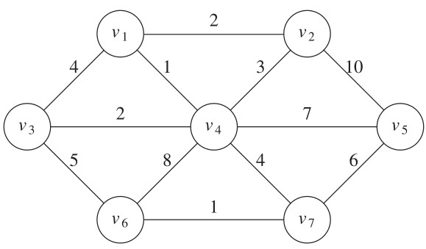
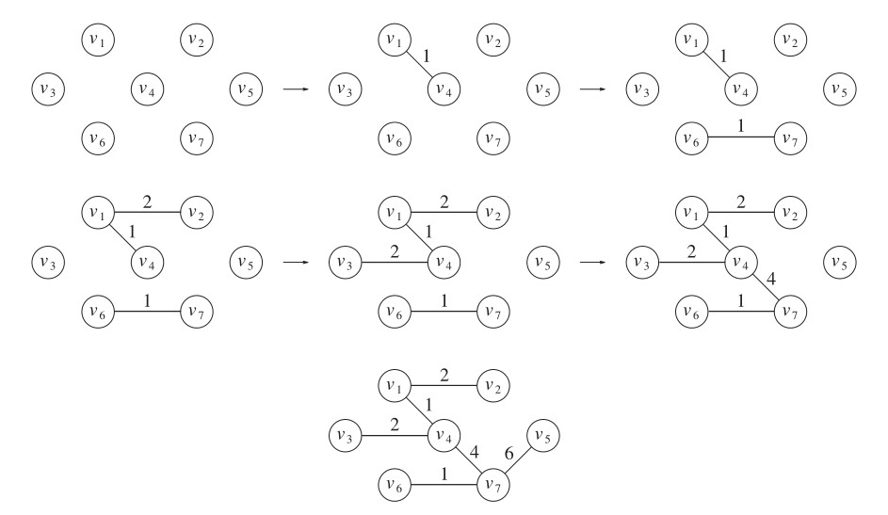
Graph G
Spanning Trees

Slide 16
Minimum Cost Spanning Tree: Prim’s Algorithm
Remove loops and parallel edges [Keep min weight ]
Maintain two disjoint sets of vertices. One containing vertices that are in the growing spanning tree and other that are not in the growing spanning tree.
While adding new edge , select edge with minimum weight out of edges from already visited vertices ( no cycle allowed).
4. Stop at [n-1] edges.
Note: Step 3 can be Implemented using priority queue.
Timing Analysis of Prim’s Algorithm
The time complexity of the Prim’s Algorithm is O((V+E)* log V) because each vertex is inserted in the priority queue only once and insertion in priority queue take logarithmic time.

Slide 17
Minimum Cost Spanning Tree-Prim’s Algorithm
9
7
B
D
5
7
B
D
5
6
6
A
3
2
F
A
3
2
F
4
4
8
C
E
2
8
C
E
2
3
3
Remove loops and parallel edges [Keep min weight ]
While adding new edge , select edge with minimum weight out of edges from already visited vertices ( no cycle allowed).
3. Stop at [n-1] edges.
B
D
7
A
3
2
F
2
C
3
E

Slide 18
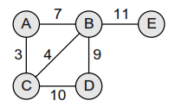
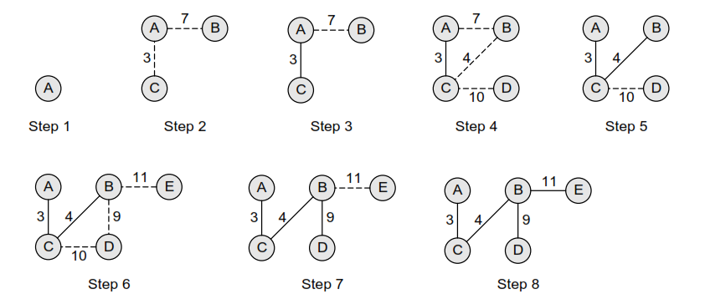
MST using Prim’s algorithm after each stage
Cost=3+4+9+11=27

Slide 19
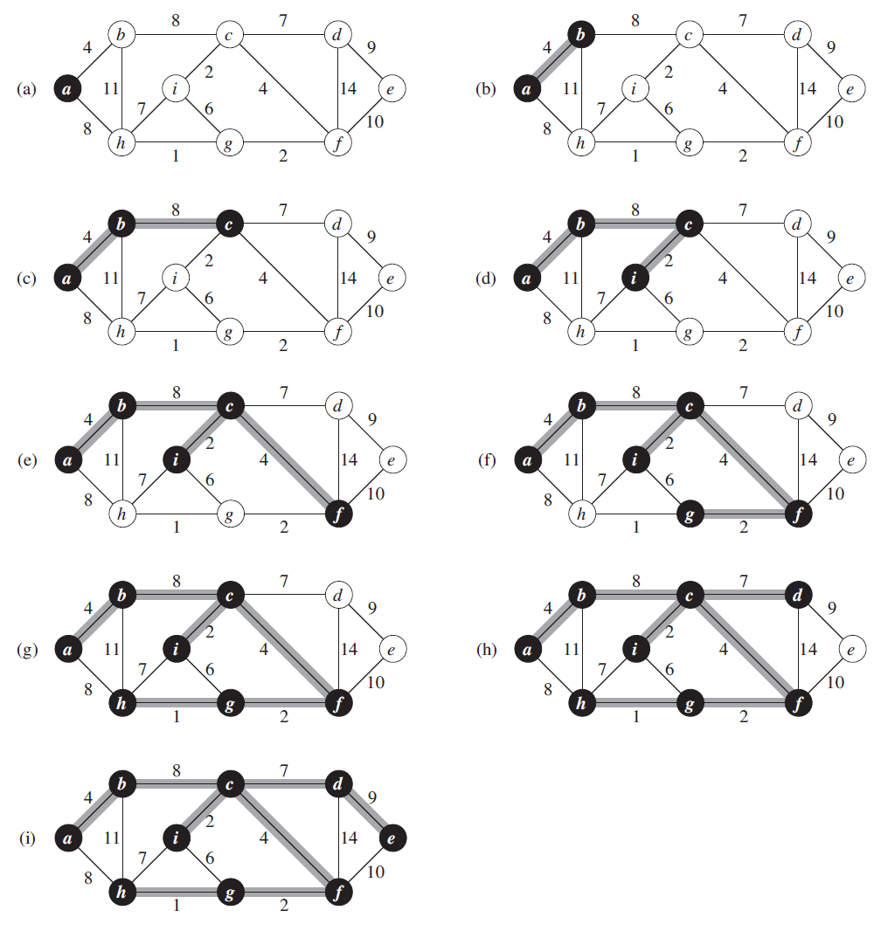

Slide 20
Minimum Spanning Trees Algorithm- Prim’s
Remove loops and parallel edges [Keep min weight ]
While adding new edge , select edge with minimum weight
out of edges from already visited vertices ( no cycle allowed).
3. Stop at [n-1] edges.
6
b
C
4
3
3
d
a
1
2
2
4
e
f

Slide 21
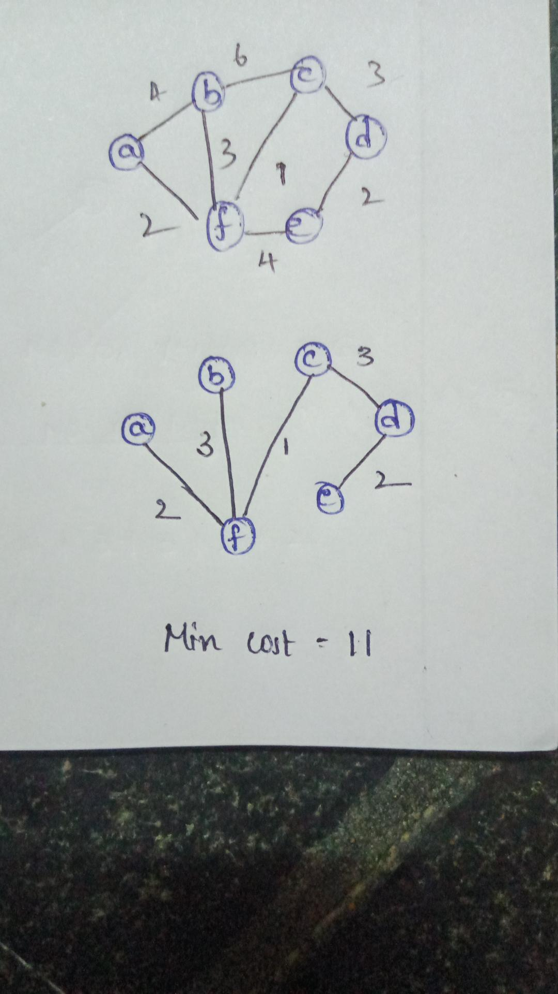
Minimum Spanning Trees Algorithm- Prim’s
Remove loops and parallel edges [Keep min weight ]
While adding new edge , select edge with minimum weight
out of edges from already visited vertices ( no cycle allowed).
3. Stop at [n-1] edges.
6
b
C
4
3
3
d
a
1
2
2
4
e
f

